Slide 1

Practical AI: Using AI for administrative functions in bar associations & law firms
2023 Mid-Atlantic Bar Conference
National Harbor
September 27, 2023
Dave Pantzer
dpantzer@mlsc.org
Lee Sampson
Leland.sampson@mdcourts.gov
A cookbook in fifteen stories

Slide 2
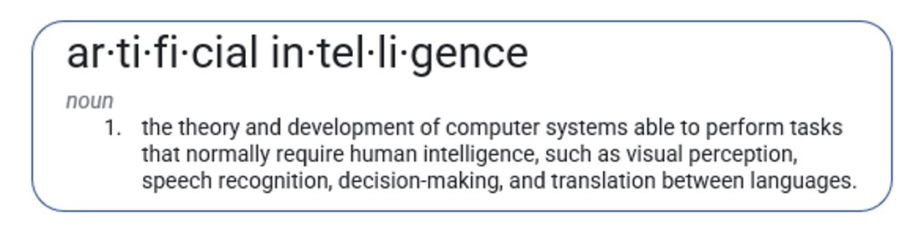
Introduction
Pet peeve with technology talks…
Notes:
Dave

Slide 3
Large Language Models
A large language model
"understands" through statistical analysis and probability
"creates" through combination of pattern, probability, and random sampling
Notes:
Lee

Slide 4
Large Language Models
Good at:
Coherence
Summarizing large chunks of text
Re-writing text
First drafts when provided with detailed prompts
Bad at:
Searching for information (though some have been integrated with search engines)
Providing accurate facts
Notes:
Lee

Slide 5
Recognized Dangers
Fictional information – dangerously plausible nonsense
Training bias – Garbage in, Garbage out
Privacy – who “learns” from your prompts?
Job elimination
Weaponization

Slide 6
TOC
Topic | Tool
Chatbots: Audience/Tone | ChatGPT
Chatbots II: Clear writing | Claude
Chatbots III: Host your own | GPT4All
Beyond a spell checker | Grammarly
Chatbots IV: Structured output | ChatGPT, Phind
Browser extensions | Monica
Audio to Text | Otter.ai, Word, Monica
Phone support bot | Air.ai
Image manipulation | Remove.bg
Image creation | Canva, Stable Diffusion, MidJourney, Bing
Video creation | Synthesia
Document interrogation | Claude.ai, ChatPDF
Query custom dataset | Ferretit.ai
PowerPoint creation | Gamma.app
Enterprise solutions | MS Copilot, Google Duet

Slide 7
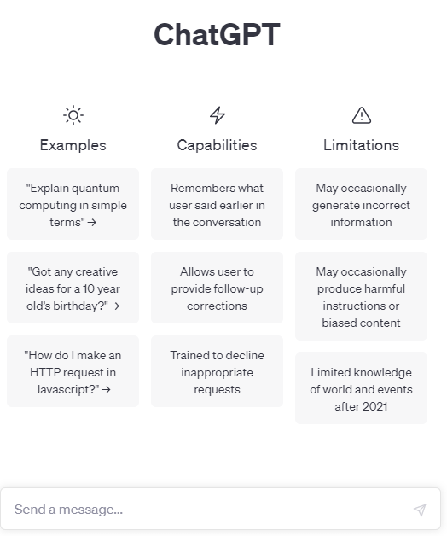
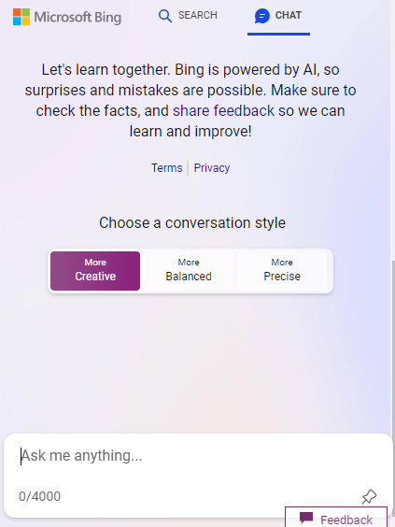
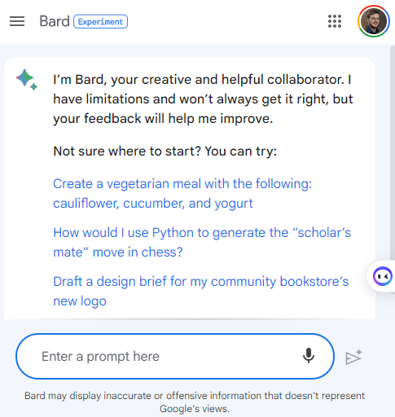
The rise of the chatbots, or Talking to my computer
ChatGPT https://chat.openai.com | Bing Chat https://www.bing.com > Click Chat (From Edge) | Google https://bard.google.com | Others…
 |  |  | CLAUDE.AI
Notes:
Dave
These are three of the most popular
Bing – adds citations

Slide 8
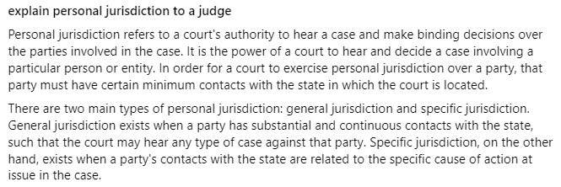
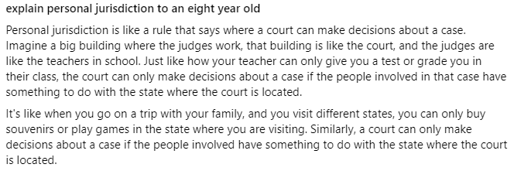
Talking to my computer
Audience
Tone/style (e.g., toning back an angry letter)
Generate an email telling X that Y
Notes:
Dave
Chat GPT

Slide 9

Talking to my computer: Drafting content, fast
You run a paid membership-based professional association for lawyers. Write a telephone script to be used by an intern to help them make calls to lawyers who have not renewed their membership. The script should include full back and forth conversation between the intern and the lawyer. The lawyer will present at least five common objections to renewing the membership, and the intern will provide polite, effective responses to convince the lawyer to renew.
Notes:
Dave
Chat GPT

Slide 10
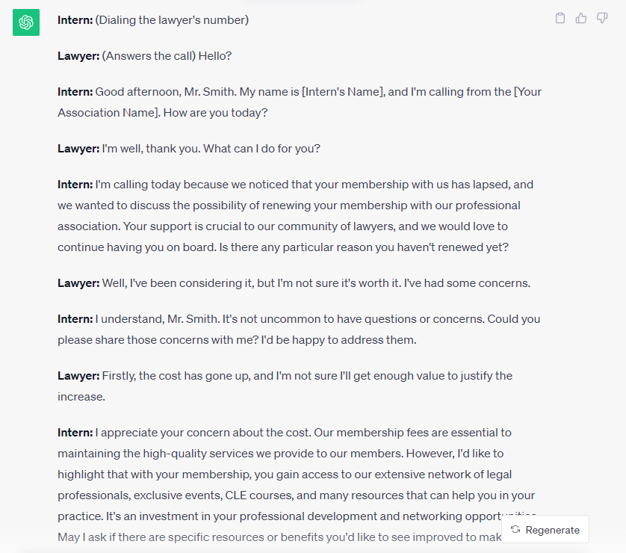
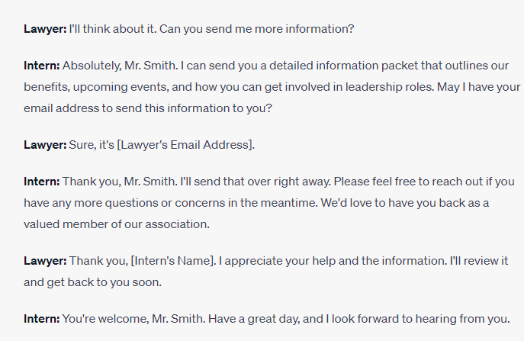
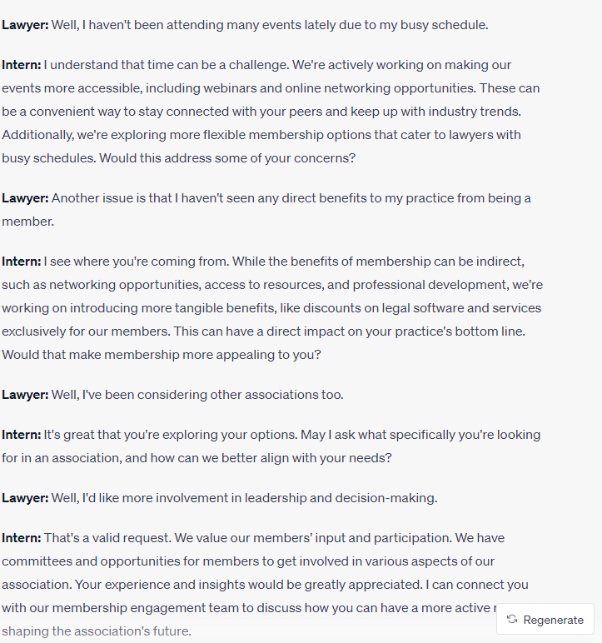
Concerns: Cost; busyness; ROI; other associations; participation
Notes:
Dave
Chat GPT

Slide 11


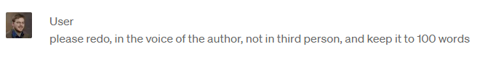
Talking to my computer Editing content – getting a 600-word answer to 137
Notes:
Lee

Slide 12
Talking to my computer Claude.ai
Prompt: You are a clear writing teacher in a first-year law school class. A student submits this sentence as part of an assignment: “It is understood by artist and company that comprehensive liability insurance, protecting against any claim or demand up to $300,000, including attorney’s fees, related to company’s actions under this venue agreement, shall be purchased and maintained throughout the agreement by company.” Suggest a way to write the sentence that avoids the center- embedding problem. The rewrite can be multiple sentences.
Notes:
Lee
Purpose is to demonstrate a creative way to write a prompt. Also, the answer provided by Claude AI was much, much better than what I got from ChatGPT.

Slide 13
Talking to my computer Claude.ai
Answer:
Here is one way to rewrite that sentence to avoid the center-embedding problem:
The company agrees to purchase and maintain comprehensive liability insurance throughout the term of this venue agreement. The insurance coverage will protect against any claim or demand up to $300,000, including attorney's fees. This insurance will cover claims related to the company's actions under this agreement.
By breaking it into multiple sentences, the relationships between the ideas are clearer. The key points - the insurance requirement, the amount of coverage, and what it covers - are each expressed in their own sentence. This structure avoids embedding clauses within clauses, which can make complex sentences hard to follow. The rewrite aims to be clear and concise while preserving all the key information from the original.
Notes:
Lee

Slide 14
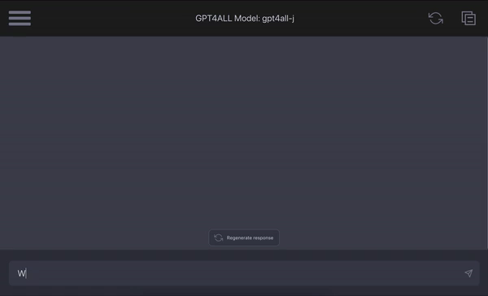
GPT4All

Slide 15
Talking to my computer GPT4All
﻿﻿Prompt: what are some ways a large language model can help me implement a marketing plan?

Slide 16
Talking to my computer GPT4All
﻿Answer:
A large language model like GPT-3 can help you with several aspects of your marketing plan. Here are some examples:
1. Content generation: You can use the language model to generate high-quality, engaging content for your website, social media platforms, and other marketing channels. This will save you time and effort while ensuring that your messaging is consistent and effective.
2. Sentiment analysis: The language model can help you analyze customer reviews, feedback, and comments on social media platforms to identify trends, pain points, and opportunities for improvement in your products or services.
3. Predictive marketing: You can use the language model to predict which customers are most likely to churn, based on their past behavior and engagement with your brand. This will help you target your marketing efforts more effectively and improve customer retention rates.
4. Competitive analysis: The language model can help you analyze your competitors' marketing strategies, tactics, and messaging to identify opportunities for differentiation and improvement in your own marketing plan.
5. Market research: You can use the language model to gather insights into consumer behavior, preferences, and needs in your target market. This will help you tailor your marketing efforts more effectively and improve customer satisfaction rates.

Slide 17
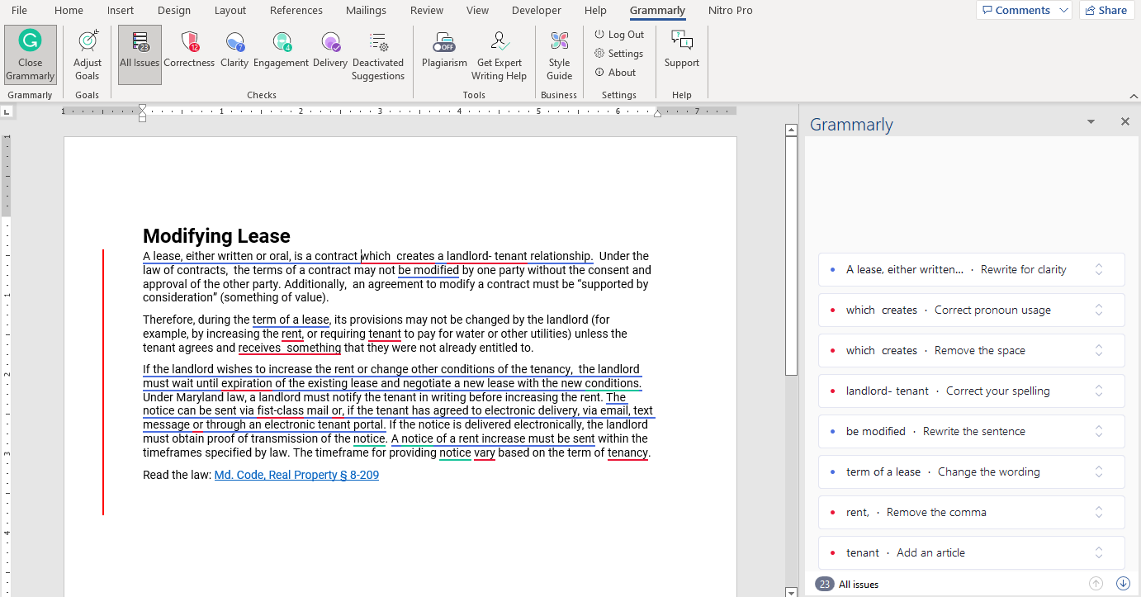
Going beyond a spell checker - Grammarly
Basic spelling and grammar checking
Tone analysis
Clarity analysis

Slide 18
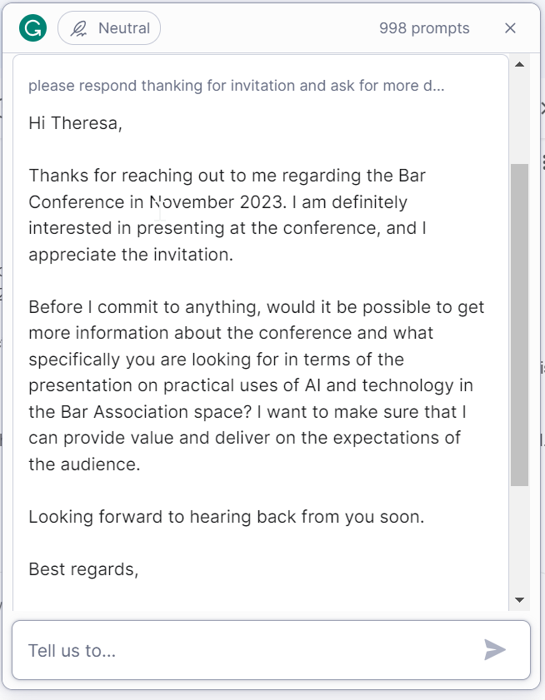
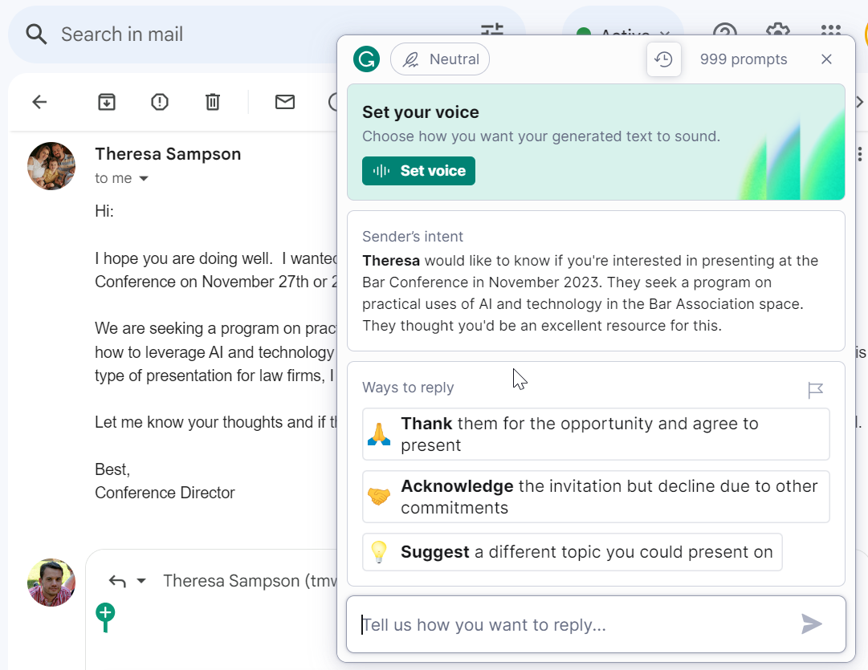
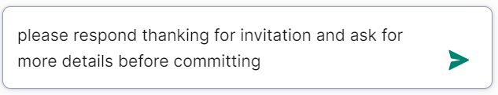
Going beyond a spell checker - Grammarly
Email triage with Grammarly Go

Slide 19
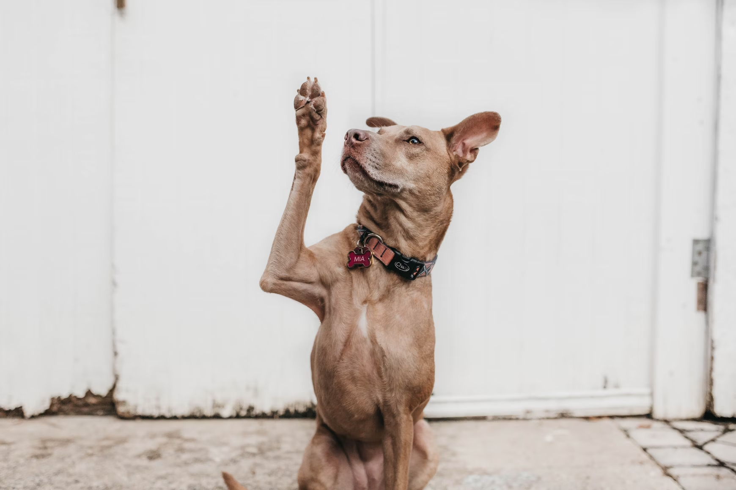
Questions, comments, observations

Slide 20
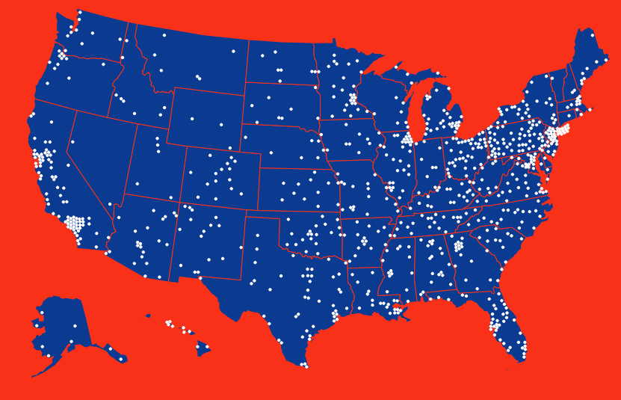
Pins on a map –help with discrete tech tasks
ChatGPT
Google stuff

Slide 21
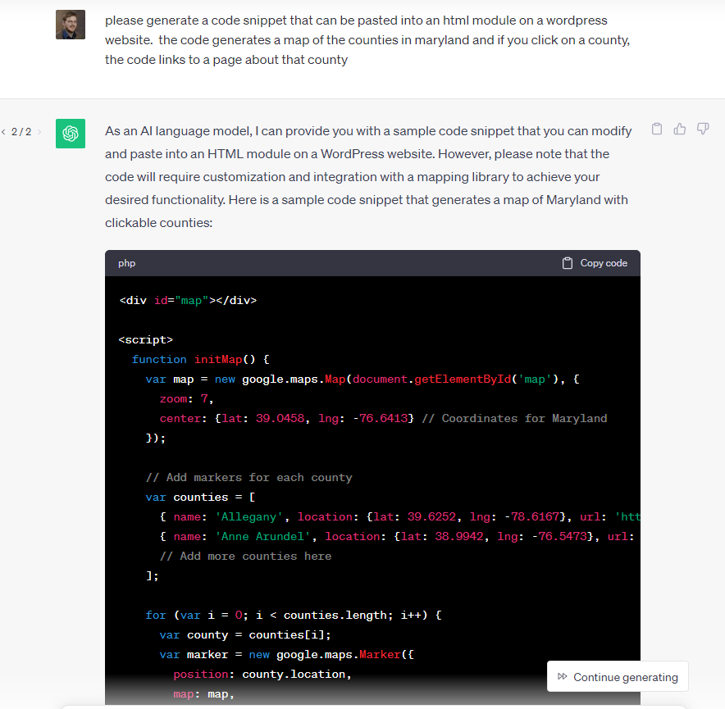
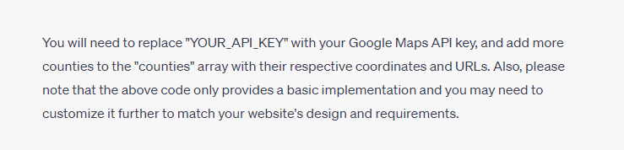

Slide 22
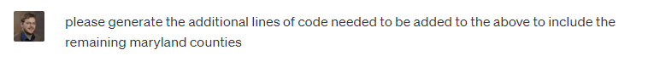
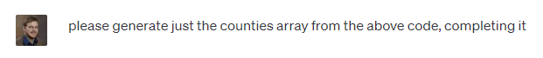
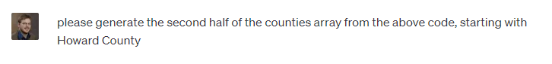


Slide 23
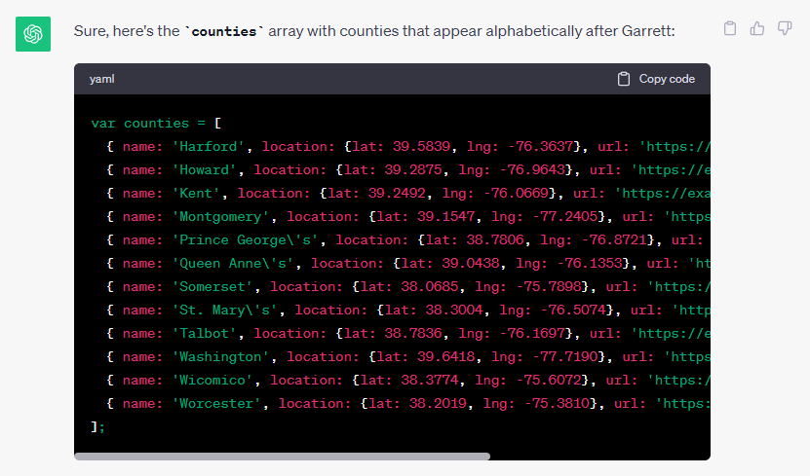

Slide 24
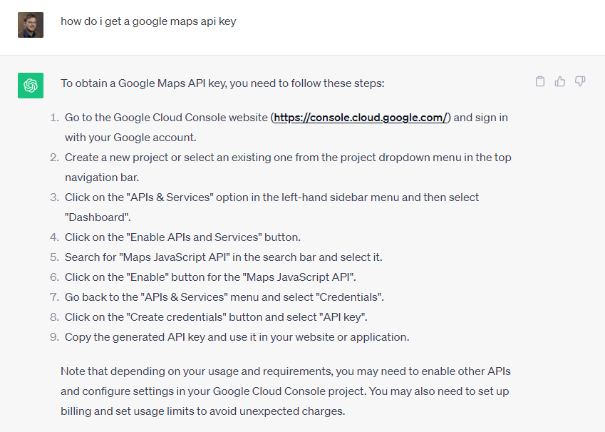

Slide 25
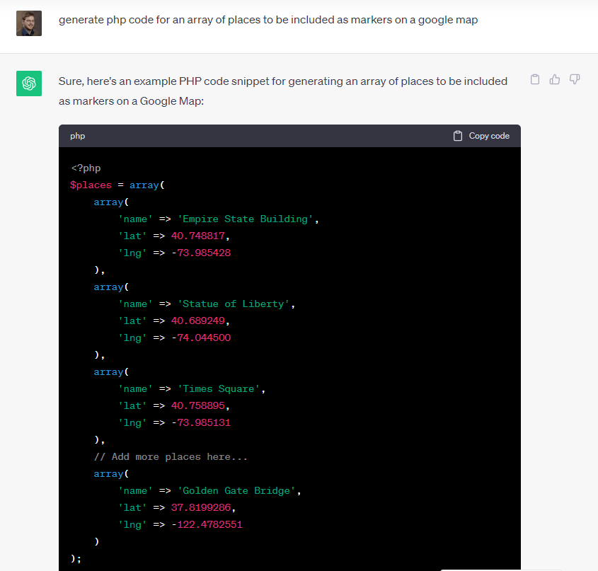

Slide 26
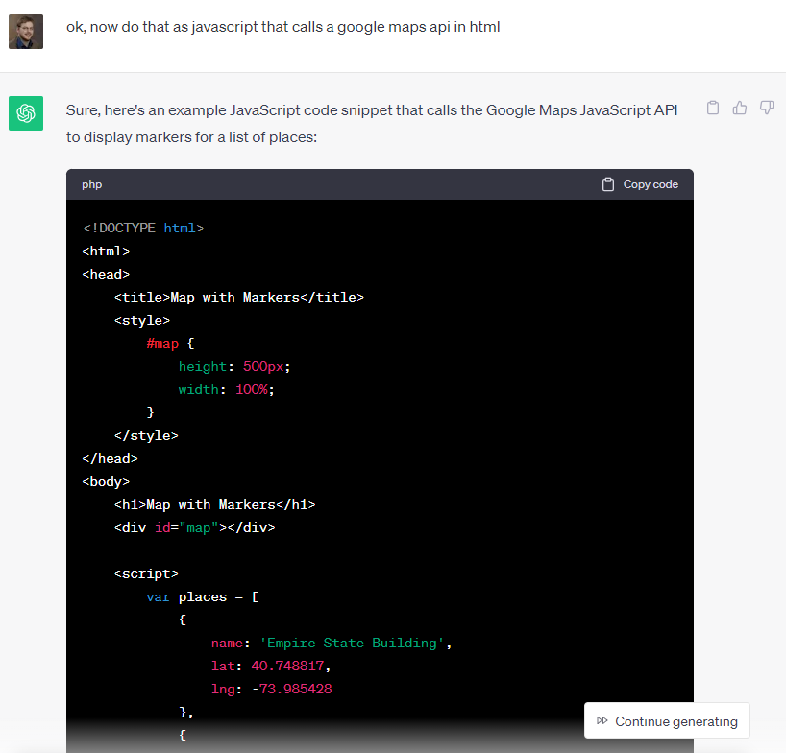

Slide 27
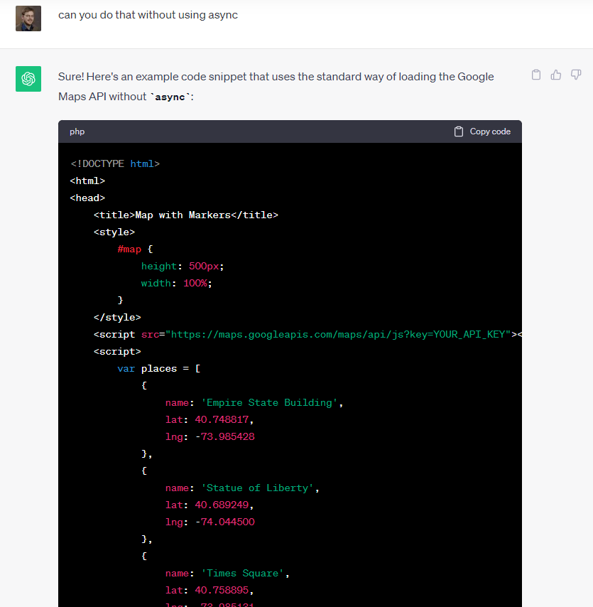

Slide 28
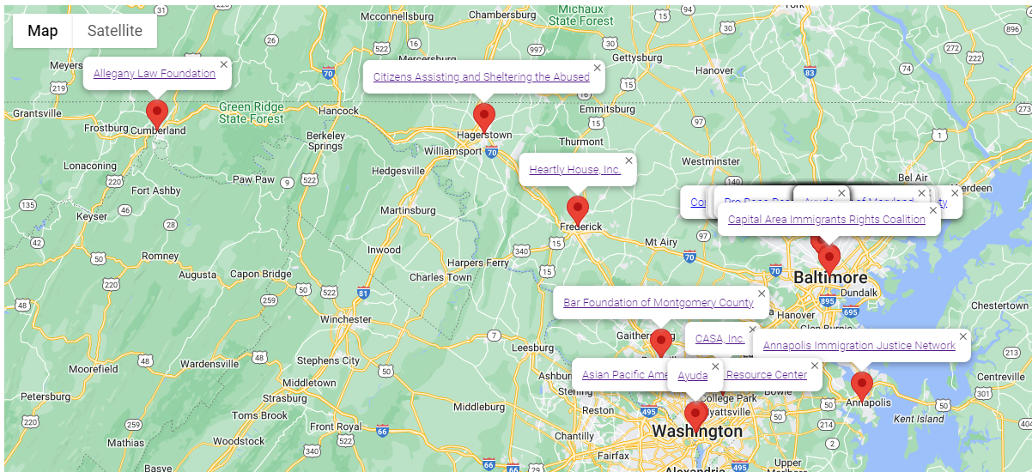
Pins on a map –help with discrete tech tasks
ChatGPT
Google stuff

Slide 29
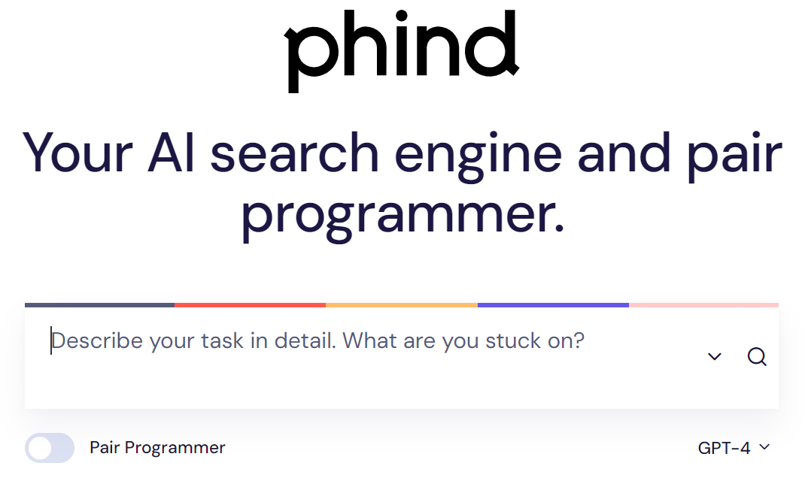
Phind.com
Prompt: please generate the css and html for a basic website. On the desktop size, the site should have a masthead. The masthead should be as wide as the page and take up the top 25% of the page. Text for the masthead: This is the masthead of the site. The masthead should be light blue. Below the masthead should be two columns. In the desktop view, the left column should take up 20% of the page width and be a menu with links to a homepage and an about page. In the desktop viewport, the right column should take up 80% of the page width and be the main content area. Below the two columns should be a footer. On the mobile size, the masthead should be on top, then the left column, then the right column, then the footer. Add a CSS media query so that when the page width is less than 600 px the container rows stack

Slide 30
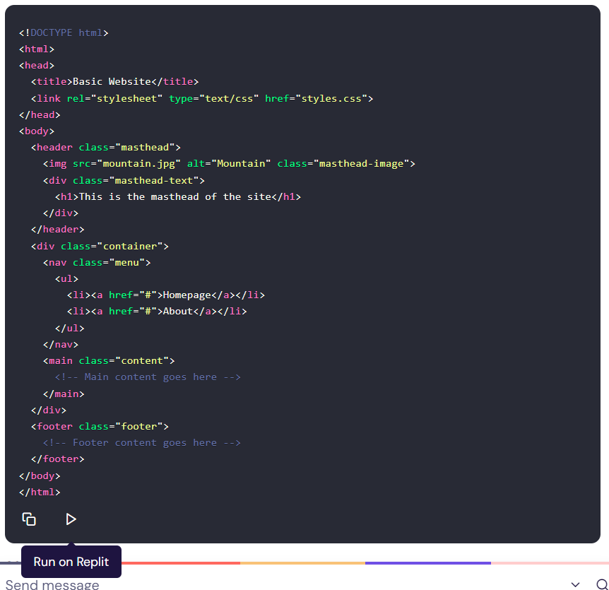
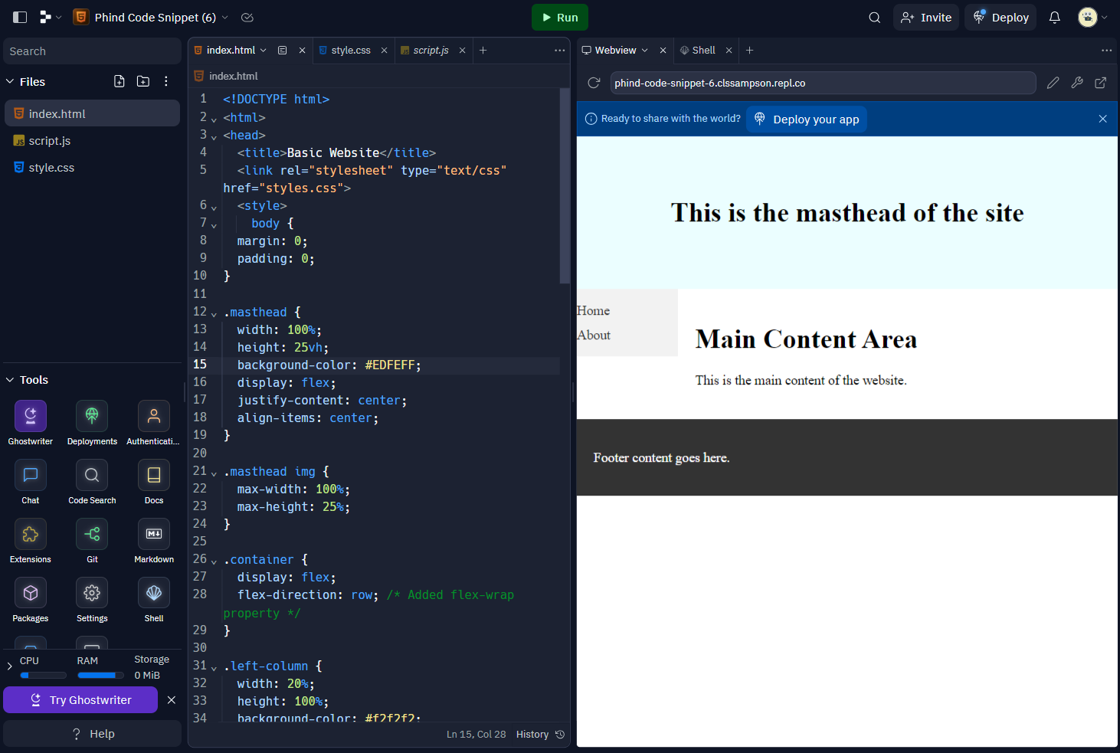

Slide 31
https://phind-code-snippet-6.clssampson.repl.co/

Slide 32
Browser extensions
ChatGPT for Google Monica
Notes:
Should we include the Search Generative Experiment to Google search here?

Slide 33
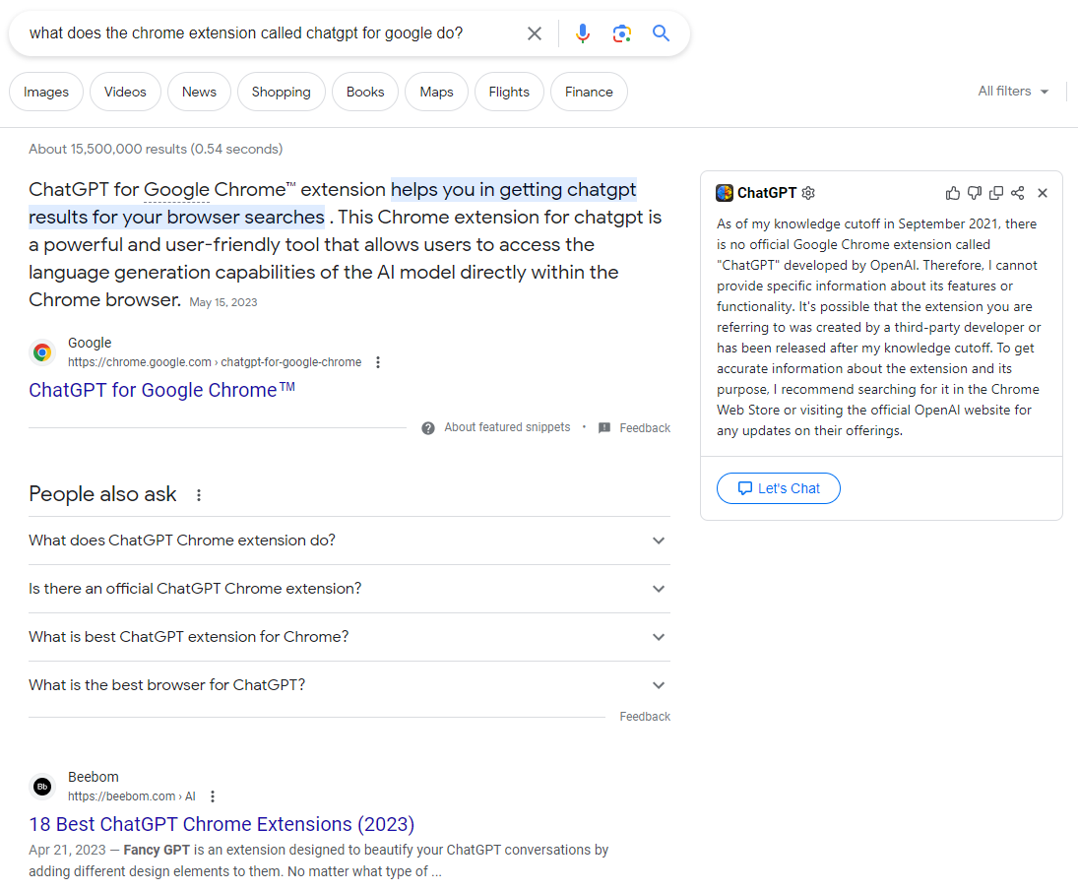
Some handy integrations
ChatGPT for Google (Chrome Extension)

Slide 34
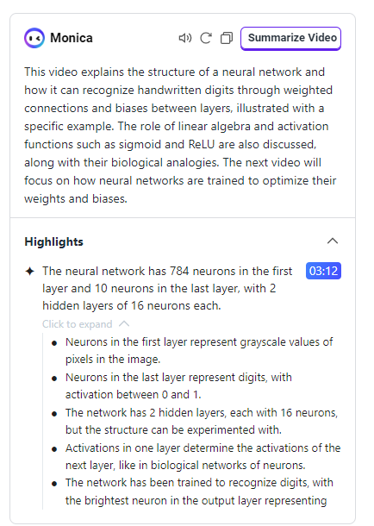
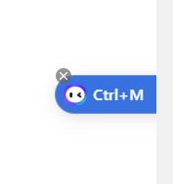
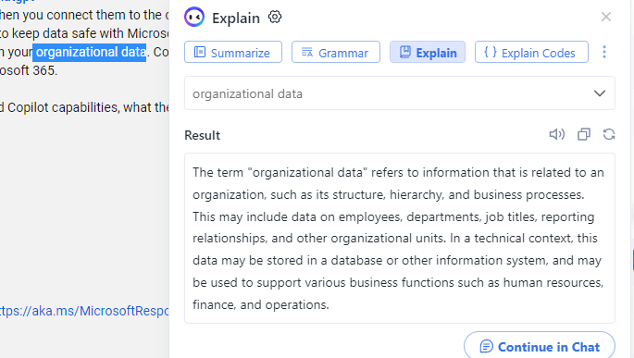
Some handy integrations
Monica (Chrome Extension)

Slide 35
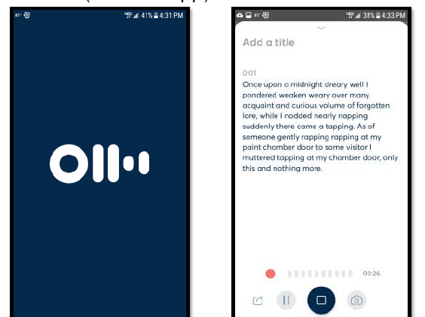
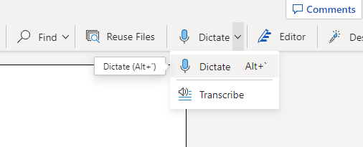
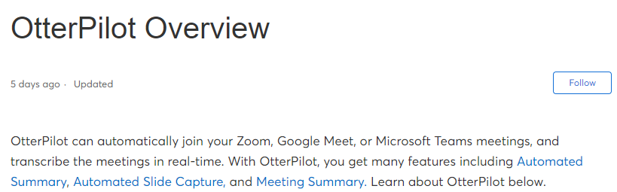
What did you say?
Monica
Word online
Otter.ai
Notes:
Maybe expand the Otter.ai example to include Zoom integration? It can take notes and produce an action items list from transcripts

Slide 36
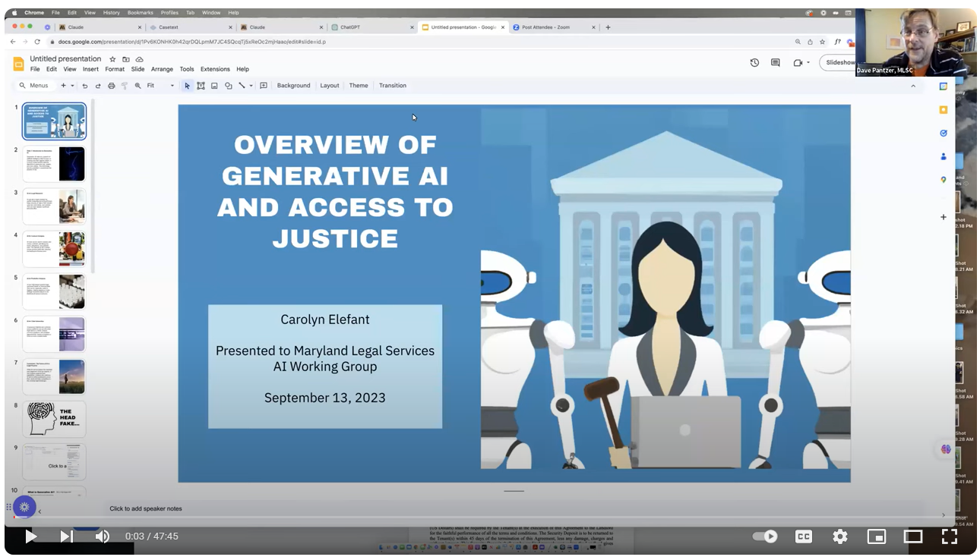
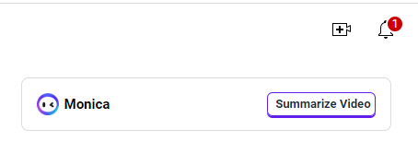
What did you say?
Monica
Word online
Otter.ai
https://www.youtube.com/watch?v=5bpWL9Z2RlE

Slide 37
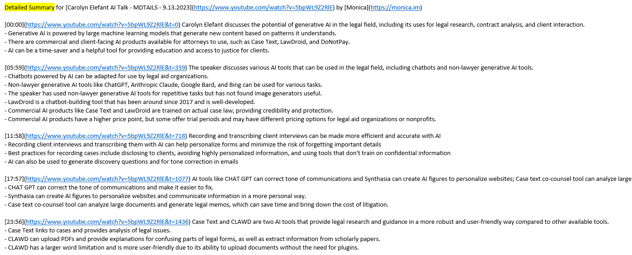
Summary: Attorney Carolyn Elefant discusses the potential uses of generative AI in the legal field, including legal research, contract analysis, and client interaction. She also mentions commercial and free AI tools that can be used to improve access to justice. Elefant shares her personal experience using AI to record and transcribe client interviews, while also addressing ethics and confidentiality concerns. (Generated by Monica from YouTube video)

Slide 38
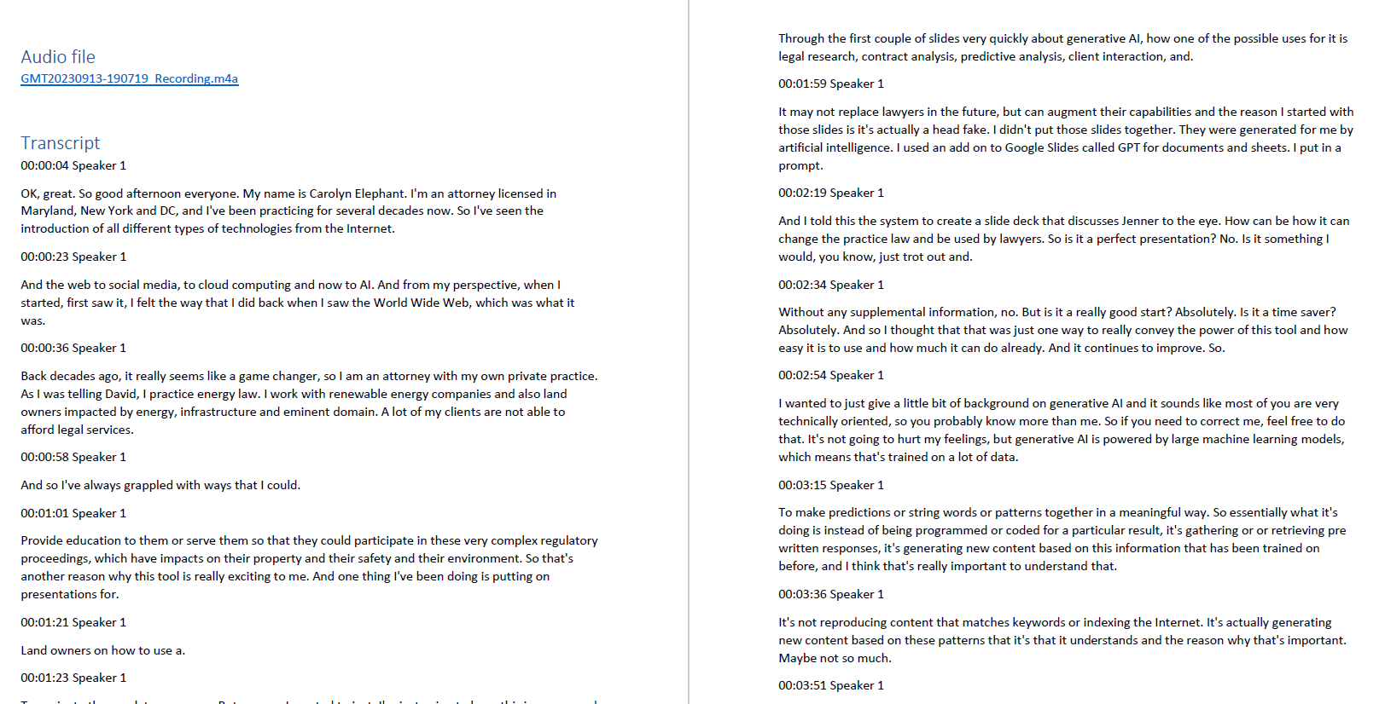

Slide 39
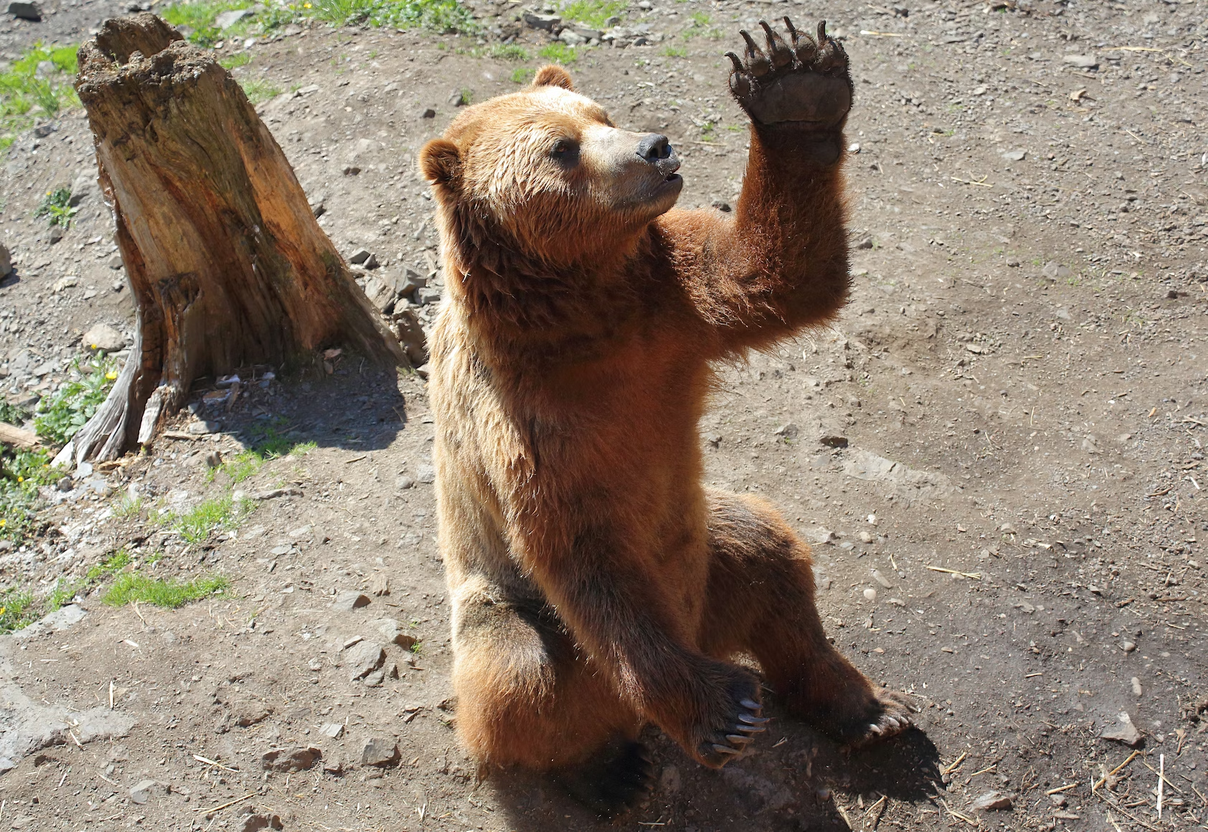
Questions, comments, observations

Slide 40
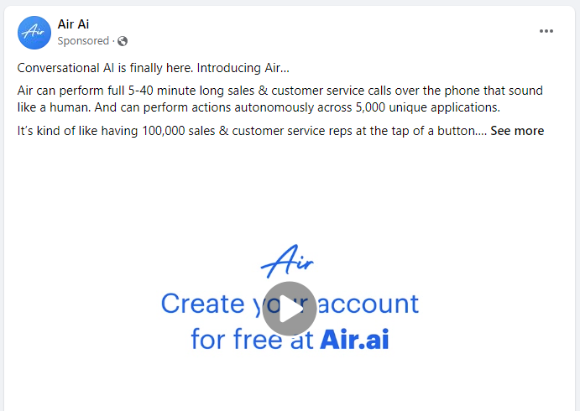
AI, don’t you lose my number…
Air.ai

Slide 41
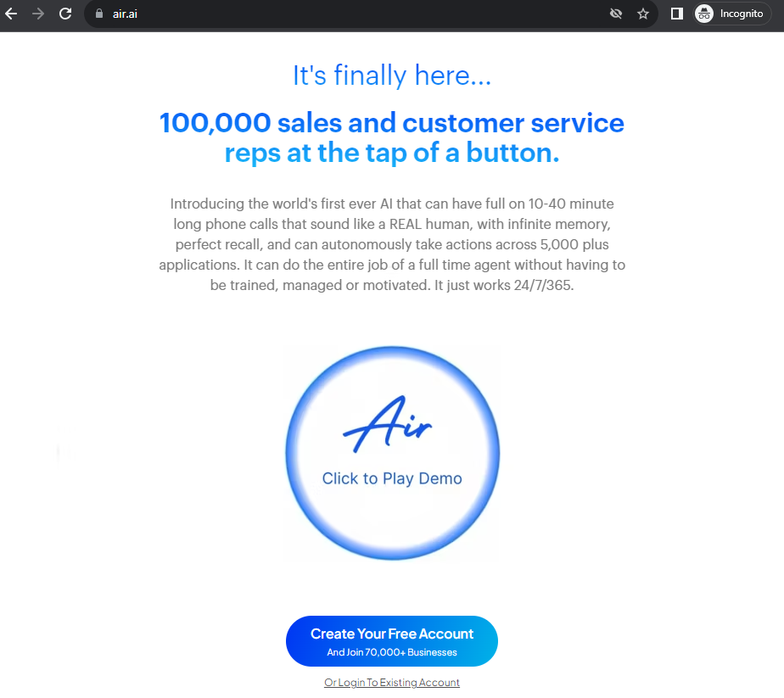

Slide 42
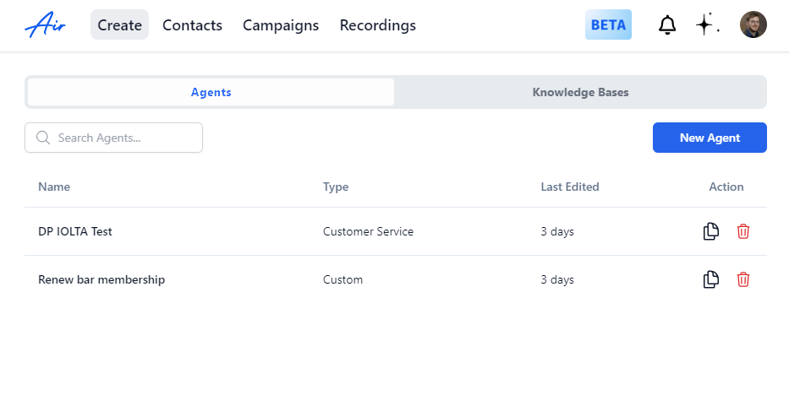

Slide 43
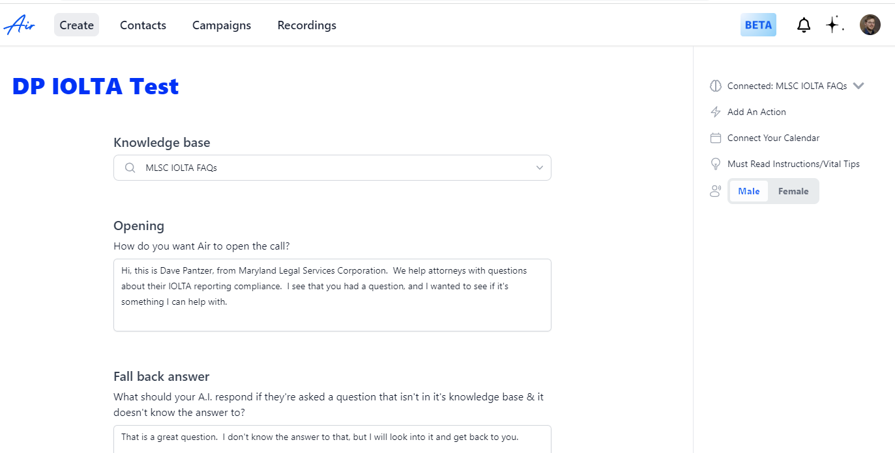


Slide 44
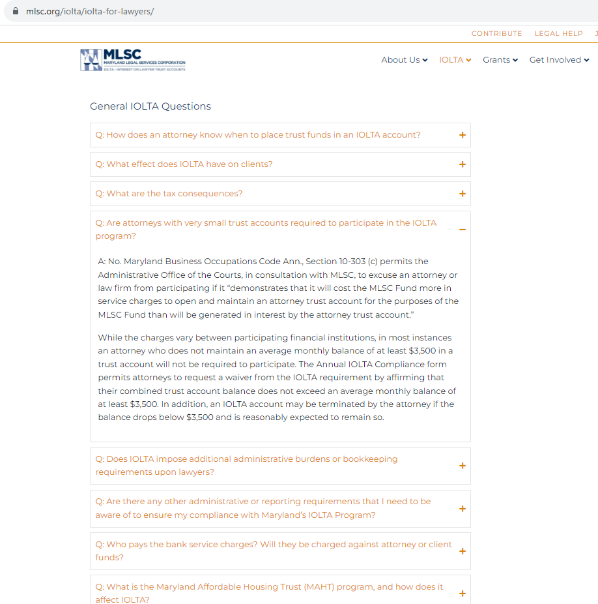

Slide 45
AI, don’t you lose my number…
https://fb.watch/neVCGhy5Am/?mibextid=CDWPTG

Slide 46
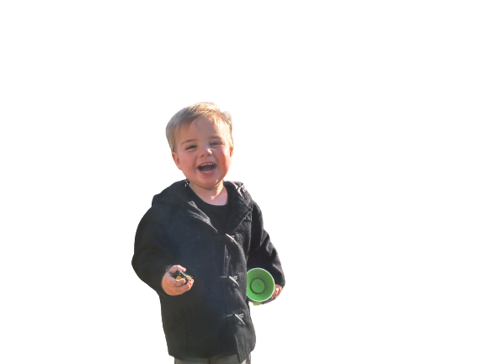
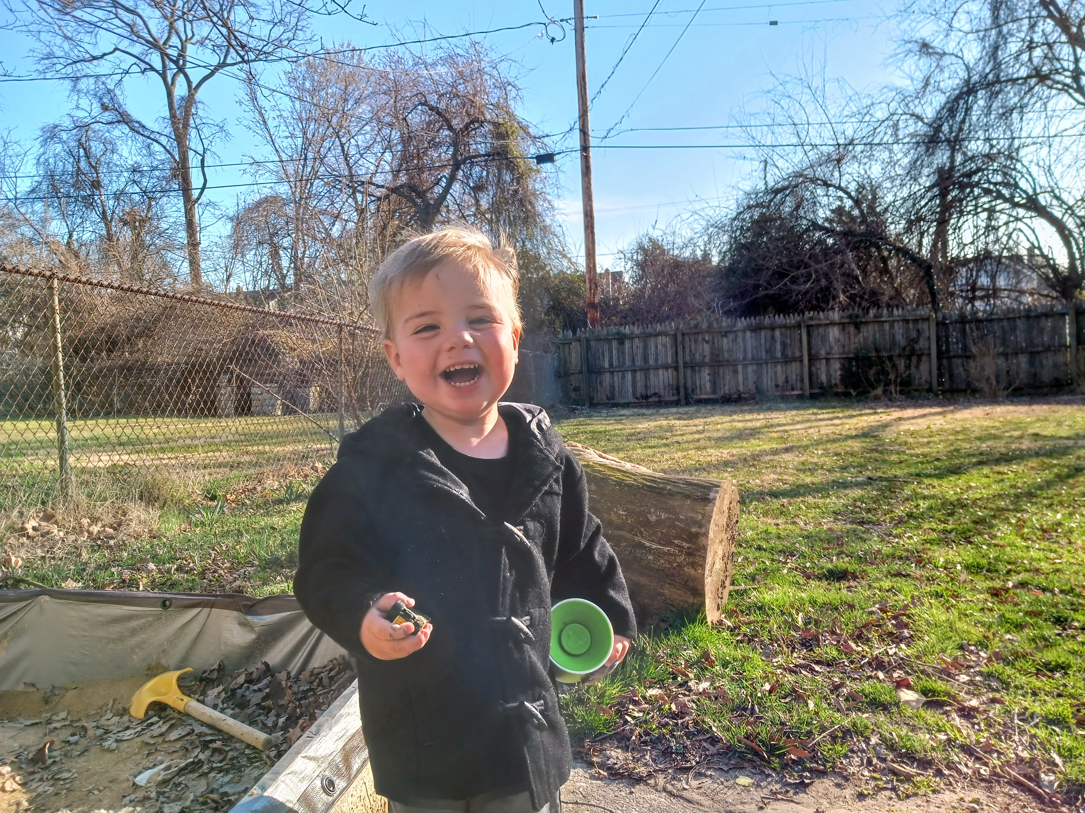
Image manipulation and creation
Notes:
Remove.bg
Office applications
PhotoLayers (Android app)

Slide 47
Image manipulation and creation
Notes:
https://huggingface.co/spaces/stabilityai/stable-diffusion

Slide 48

Image manipulation and creation
Bing Chat (free)
Prompt: create a photorealistic image of an old evergreen forest at morning with sunrays peaking through, cinematic lighting

Slide 49

Image manipulation and creation
Bing Chat (free)
Prompt: Produce a stunning and highly realistic image through stable diffusion, depicting an aged evergreen forest bathed in the soft morning light. Capture the essence of cinematic lighting as gentle sunrays pierce through the dense foliage, creating an enchanting and visually captivating scene.

Slide 50

Image manipulation and creation
Mid Journey (paid)
Prompt: create a photorealistic image of an old evergreen forest at morning with sunrays peaking through, cinematic lighting

Slide 51

Image manipulation and creation
Mid Journey (paid)
Prompt: Produce a stunning and highly realistic image through stable diffusion, depicting an aged evergreen forest bathed in the soft morning light. Capture the essence of cinematic lighting as gentle sunrays pierce through the dense foliage, creating an enchanting and visually captivating scene.

Slide 52




AI and law?
Please make me a picture of george washington and barack obama having a conversation in a business office while a robot sits at a desk nearby. The robot is obviously an administrative assistant. (Stable Diffusion)

Slide 53

AI and law?
Please make me a picture of george washington and barack obama having a conversation in a business office while a robot sits at a desk nearby. The robot is obviously an administrative assistant. (Bing)

Slide 54

AI and law?
Please make me a picture of george washington and barack obama having a conversation in a business office while a robot sits at a desk nearby. The robot is obviously an administrative assistant. (Canva AI)

Slide 55


AI and law?
Please provide a photo-realistic picture of ten attorneys meeting in a conference room to watch an educational lecture on a screen (Canva)

Slide 56


AI and law?
Please provide a photo-realistic picture of ten attorneys meeting in a conference room to watch an educational lecture on a screen (Bing Chat)

Slide 57


AI and law?
Please provide a photo-realistic picture of ten attorneys meeting in a conference room to watch an educational lecture on a screen (Mid Journey)

Slide 58
How about a logo for a conference?
ChatGPT:
please suggest five good image-generation prompts for dall-e to generate a logo for the following event: The 2023 Mid-Atlantic Bar Conference will be held at the MGM National Harbor, in Oxon Hill, Maryland. This conference will be for bar association leaders from the State Bars of Delaware, Maryland, New Jersey, New York, Pennsylvania, and the District of Columbia.

Slide 59

"Create a logo for the 2023 Mid-Atlantic Bar Conference with a modern and professional look. It should combine the architectural beauty of the MGM National Harbor and the essence of unity among legal professionals from Delaware, Maryland, New Jersey, New York, Pennsylvania, and D.C. Make it impactful and memorable."

Slide 60

AI and law?
"Create a logo for the 2023 Mid-Atlantic Bar Conference with a modern and professional look. It should combine the architectural beauty of the MGM National Harbor and the essence of unity among legal professionals from Delaware, Maryland, New Jersey, New York, Pennsylvania, and D.C. Make it impactful and memorable.“ (Bing)

Slide 61

AI and law?
"Create a logo for the 2023 Mid-Atlantic Bar Conference with a modern and professional look. It should combine the architectural beauty of the MGM National Harbor and the essence of unity among legal professionals from Delaware, Maryland, New Jersey, New York, Pennsylvania, and D.C. Make it impactful and memorable.“ (Stable Diffusion)

Slide 62
AI and law?
Canva ran out of prompt characters:
“Create a logo for the 2023 Mid-Atlantic Bar Conference with a modern and professional look. It should combine the architectural beauty of the MGM National Harbor and the essence of unity among legal professionals from Delaware, Maryland, New Jersey, New York, Pennsylvania, and D”
OK – shorten:
Design a logo for the “2023 Mid-Atlantic Bar Conference” featuring a stylized representation of the National Harbor ferris wheel against a backdrop of the Chesapeake Bay sunset, with the event's name elegantly incorporated.

Slide 63



Design a logo for the “2023 Mid-Atlantic Bar Conference” featuring a stylized representation of the National Harbor ferris wheel against a backdrop of the Chesapeake Bay sunset, with the event's name elegantly incorporated.
Bing | Stable Diffusion | Canva

Slide 64

Design a logo for the “2023 Mid-Atlantic Bar Conference” featuring a stylized representation of the National Harbor ferris wheel against a backdrop of the Chesapeake Bay sunset, with the event's name elegantly incorporated. (Canva)

Slide 65

AI and law?
Back to a good old google image search for a reality check…

Slide 66

AI and law?
Design a logo for a Conference featuring an impressionist representation of the National Harbor ferris wheel against a backdrop of the Chesapeake Bay sunset. Incorporate the exact text "MABC 2023". (Canva)

Slide 67

AI and law?
Design a logo for a Conference featuring an impressionist representation of the National Harbor ferris wheel against a backdrop of the Chesapeake Bay sunset. Incorporate the exact text "MABC 2023". (Stable Diffusion)

Slide 68

AI and law?
Design a black and white logo for a Conference in a magazine illustration style. The logo should feature a representation of the National Harbor ferris wheel against a backdrop of the Chesapeake Bay sunset. Incorporate the exact text "MABC 2023". (Stable Diffusion)

Slide 69

AI and law?
Design a black and white logo for a Conference in a magazine illustration style. The logo should feature a representation of the National Harbor ferris wheel against a backdrop of the Chesapeake Bay sunset. Incorporate the exact text "MABC 2023". (Canva)

Slide 70

Free image generation on your computer
Fooocus (https://github.com/lllyasviel/Fooocus)
https://www.fal.ai/models/fooocus
Prompt: As the sun sets, the trees whisper, while the river gracefully meanders, reflecting beautiful colors, majestic mountains stand tall, evoking tranquility and harmony, butterflies dance in the air, the mysterious connection between sky and earth, colorful objects.

Slide 71
Video creation
Synthesia
https://www.onlinejudge.us/040391355937/ai

Slide 72

Questions, comments, observations

Slide 73



Make it do my homework?
Claude.ai allows you to upload a PDF and then interrogate it.
This makes a helpful starting point if someone asks you for a bio and all you have is your resume.

Slide 74

Asking the document a question
The Maryland CLE regulation example…
Claude.ai
ChatPDF

Slide 75


Asking the document a question
The Maryland CLE regulation example…
Claude.ai
ChatPDF

Slide 76


Slide 77


Slide 78


Slide 80


Slide 81


Slide 82


Slide 83


AI, explain the law to me

Slide 84

pll.ferretit.ai

Slide 85

pll.ferretit.ai

Slide 86
pll.ferretit.ai

Slide 87

pll.ferretit.ai

Slide 88

Give a presentation in five minutes!
Gamma.app

Slide 89

Give a presentation in five minutes!
Gamma.app

Slide 90


Give a presentation in five minutes!
“This is a presentation for leaders of various legal bar associations in the mid-Atlantic region of the US. The topic is using AI and other technologies to benefit bar associations.”

Slide 91


Gamma.app

Slide 92



Transforming Legal Bar Associations with AI and Technology
Legal bar associations need to embrace AI and other technologies to increase efficiency and stay ahead of the competition. In this presentation, we’ll explore the most promising uses of AI and technology in association offices, how to market services to lawyers using AI, and what training staff requires to stay up-to-date.
by Dave Pantzer

Slide 93
The Benefits of AI
Improved Accuracy
With AI, there are fewer errors in legal documents and billing.
1
2
3
Increased Efficiency
Enhanced Decision Making
AI can automate repetitive tasks to save time and money.
AI can provide valuable insights into complex data sets.

Slide 94
Marketing with AI
Automated Email Campaigns
Chatbots
Personalized Content
Provide AI-powered chatbots on the association’s website to provide quick answers to common questions.
Use targeted email campaigns to promote events and CLE classes to specific lawyers based on their interests.
Use AI to create personalized content such as blog posts and newsletters based on the user’s interests and previous engagement with the association.

Slide 95

Staff Training
1
AI Basics
2
Impact on Legal Industry
Teach staff about AI terminology, how to identify business use cases, and how to assess AI tools and their limitations.
Provide training on how AI is changing the legal industry, the pros and cons of AI in the legal sector, and the ethical challenges of AI.
3
Data Analytics
Train staff on how to use analytics tools to extract insights from data sets and how to use this information to make better-informed business decisions.

Slide 96



Document Review with AI
Risk Mitigation
Cost Savings
Increased Efficiency
Use AI to review legal documents and identify contractual risks and issues before an agreement is signed.
Using AI in document review can save time and money by reducing the need for paralegal or lawyer review.
AI can analyze large data sets, such as case law or regulatory changes, quicker than human lawyers.

Slide 97
Technology in Event Management
1
Registration Process
Automate the event registration process with AI-powered chatbots and email reminders.
2
Virtual Events
Use technology to create engaging virtual events, including webinars and online networking.
3
Data Analytics
Track event engagement using analytics to get insights into what content resonates with attendees and boost attendance at future events.

Slide 98
Automating Administrative Tasks
Contract Management
Expense Reporting
Membership Management
Use AI to extract key data from contracts and automate the approval process.
Automate expense approval and reporting by using AI to process receipts, categorize expenses, and reconcile transactions.
Use AI to streamline membership renewal and onboarding processes, including sending reminders and tracking payments.

Slide 99
AI and Ethics
Guarding Against Bias
Privacy and Data Protection
Communicating with Members
Before integrating an AI solution, ensure that it doesn’t reinforce biases.
Ensure that the organization is transparent about how member data is being used and stored.
Be open and transparent in all communications with members about the organization’s use of AI and other technologies.

Slide 100
Should we be doing this?
AI Policy Generator - https://causewriter.ai/resources/how-to-create-a-practical-ai-policy/
The Seven GPT Objections to Consider (with rebuttals) https://www.wholewhale.com/tips/gpt-objections/

Slide 101

Take a quick look at everything…
https://www.youtube.com/watch?v=B2-8wrF9Okc
Microsoft Copilot
Google Duet

Slide 102

The future of AI – Beside, Outside, Inside

Slide 103

https://www.sequoiacap.com/
article/generative-ai-act-two/

Slide 104
Further reading
Prompt engineering guide: https://www.promptingguide.ai/
Great list of tools and links: https://github.com/steven2358/awesome-generative-ai
Generative AI’s Act Two (with “market map”): https://www.sequoiacap.com/article/generative-ai-act-two/

